Slide 1

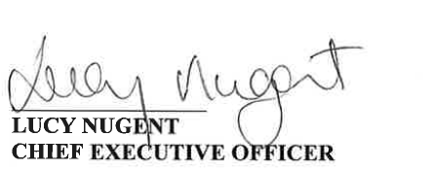

Dear Patient / Visitor
The TUH Heroes programme is a chance to celebrate staff from across the Hospital, not just the Doctors and Nurses who care for patients. The Patient Experience award is for a staff member that supports the Hospital ethos of People Caring for People to Live Better Lives.
On behalf of the Hospital, I would like to ask you to nominate a member of staff who made a real difference during your time in the Hospital. A person that showed to you or your family member they did that one extra kind thing that put themselves in your shoes. A person that went beyond what you would expect in your care or what a family member expected, delivering an ‘exceptional patient experience’.
Please see below a short form to fill out. Thank You in advance for taking the time to do so.

Slide 2
Name of the Staff Member: ……………………………………………………………………………
Department / Area they work in: …………………………………………………………………….
The reason you are nominating them
………………………………………………………………………………………………………………………….
………………………………………………………………………………………………………………………….
………………………………………………………………………………………………………………………….
………………………………………………………………………………………………………………………….
………………………………………………………………………………………………………………………….
………………………………………………………………………………………………………………………….
………………………………………………………………………………………………………………………….
………………………………………………………………………………………………………………………….
………………………………………………………………………………………………………………………….
………………………………………………………………………………………………………………………….
Your name:
….……………………………………………………………………………………………………..
Contact details:
…………………………………………………………………………………………………………
(if you would like us to let you know who wins the award this year)
Please return your completed application by post to:
Tallaght University Hospital, Tallaght, Dublin 24
Alternatively you can email us at: tallaghtheroes@tuh.ie

